Slide 1
Computer’s Software
By: Sagar Sah

Slide 2
Introduction to the software
Purpose and benefits of the software
Software
Key features and functions of the software
How the software works
User interface and design
6
Compatibility with other software and systems
7
Customization and personalization options
8
User reviews and feedback

Slide 3
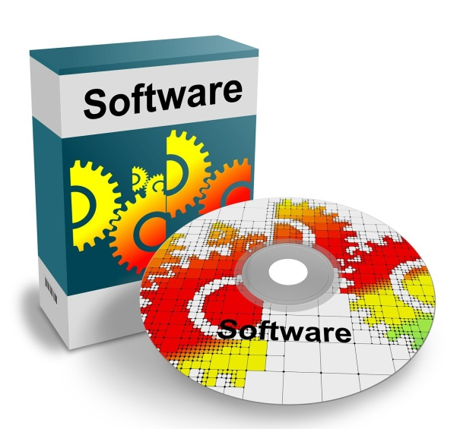
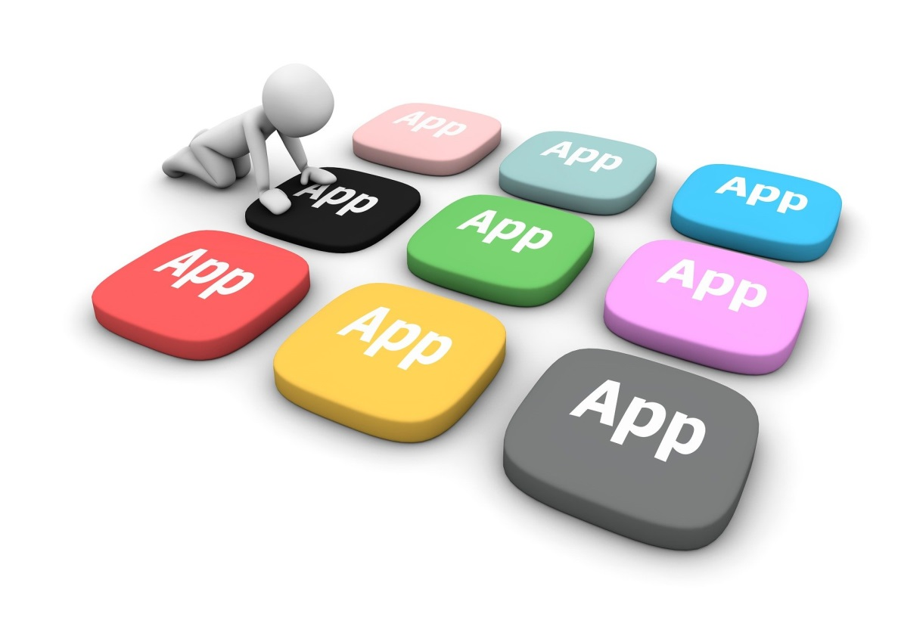

Computer’s Software
Introduction to the software
Software is a set of instructions that tells a computer or other digital device what to do. It's what enables us to use our devices to perform specific tasks, such as browsing the web, creating documents, or playing games.
The first software that was actually executed on a computer was written by a team led by Konrad Zuse in Germany in the 1930s and 1940s. Without software, our devices would be nothing more than inert pieces of hardware."
2017
2018
2021

Slide 4

Purpose and benefits of the software
Easy collaboration: Easily collaborate with on works with our colleagues.
Efficiency: Allows create presentations quickly and efficiently, saving you time and effort.
Flexibility: Allows to customize the presentation to specific needs, whether you're presenting to
a small group or a large audience.
Accessibility: It makes it easy to share presentation with others, whether through email, social media, or other online platforms.
Visual appeal: It allows to create visually appealing presentations that are engaging and can capture your audience's attention, and many more.
2017
2018
2021

Slide 5


Key features and functions of the software
User interface: A well-designed user interface is an essential feature of any software tool. The user interface should be intuitive and user-friendly.
Customization: Software should allow for customization, such as changing the font size, color, and layout of the presentation.
Templates: Many software tools offer pre-made templates for presentations, which can help users to create a professional-looking presentation quickly and easily.
Multimedia integration: As mentioned earlier, software should allow for the integration of multimedia elements such as images, videos, and audio, which can help to enhance the presentation.
These are some major key features and functions of the software.
2017
2018
2021

Slide 6

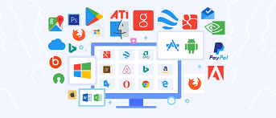
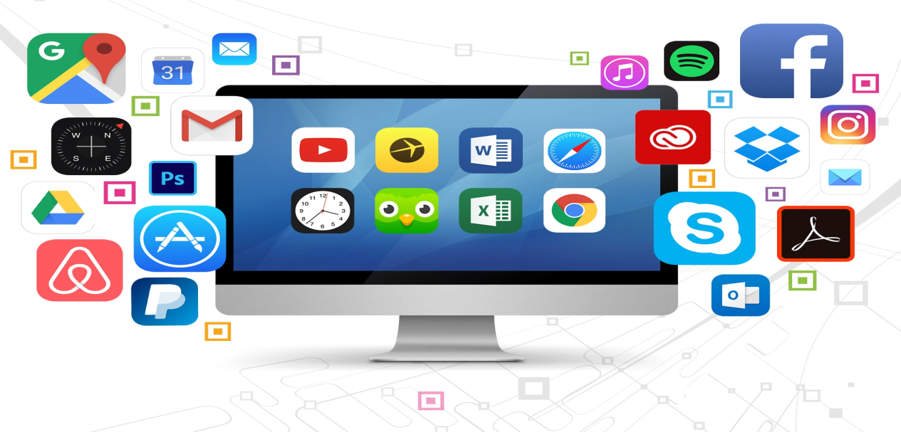
How the software works?
When a user interacts with the software, they input data or commands using the user interface. The software then processes this input, performs the necessary computations, and generates an output. This output may be displayed on the user interface, saved to a file, or transmitted to another device or application.
Overall, software works by interpreting code and processing input from the user to generate an output. The complexity of the software and the specific tasks it performs will vary depending on the intended use of the application.
2017
2018
2021

Slide 7



User interface and design
`
`
`
2017
2018
2021
Software user interface (UI) refers to the graphical and interactive components of a software application that a user interacts with to perform tasks. This can include menus, buttons, text boxes, and other visual elements that allow users to input data and navigate the software. The design of the UI plays an important role in how users interact with the software and can greatly impact the user experience.

Slide 8

Compatibility with other software and systems
`
Compatibility can be affected by various factors such as the operating system, hardware, programming language, and file formats. For example, a presentation software application must be compatible with different operating systems such as Windows, MacOS, and Linux, and must be able to read and write files in various formats such as PPTX, PDF, and HTML.
2017
2018
2021
In summary, software compatibility with other software and systems is important to ensure that the application can interact with other software and systems seamlessly, allowing users to work efficiently and effectively.

Slide 9
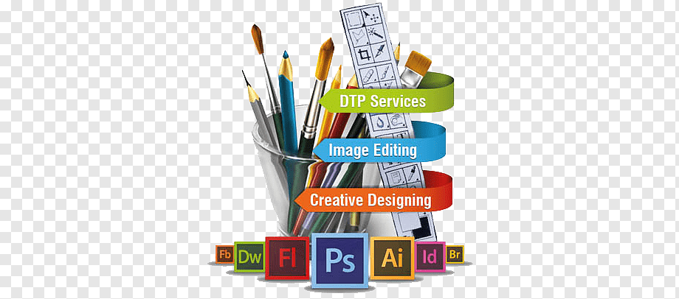


Customization and personalization options
2017
2018
2021
This includes the ability to change the user interface, features, and functionality of the software to better suit the user's preferences. Customization options may include things like changing the color scheme, font size, and layout of the user interface, or adding or removing specific features and functionalities. Personalization options may include things like setting user preferences or profiles, or using machine learning algorithms to personalize the content or recommendations presented to the user.

Slide 10

User reviews and feedback
`
2017
2018
2021
It means the opinions and comments shared by users of a software application about their experiences using the software. This feedback can include both positive and negative comments about various aspects of the software, such as its features, usability, performance, and support.

Slide 11
At last
2017
2021
Without software computer is like a empty box of pizza, so software is everything for a computer.
To make a proper system there must be best facility of software and obviously hardware too.

Slide 12
Much obliged for paying attention
THANK YOU !
Sagar Bangali Baba ke Churan Kha ke jaiha

